Slide 1

Amazon Sales Data Analysis
By:
Priyanka Datta

Slide 2
Contents
Introduction
Problem Statement
Findings
Sales Trend Analysis
Key Outcome
Conclusion

Slide 3


Problem Statement
With rising competition and the need for cost-effective distribution, effective sales management is essential. The goal is to boost profitability while reducing costs.
A detailed analysis of Amazon's sales trends—month-wise, year-wise, and yearly month-wise—was conducted to identify key metrics and factors affecting sales performance.
Understanding these relationships will help optimize sales strategies and improve distribution methods to increase profits.
Problem
Statement
3

Slide 4
Introduction
Amazon, founded by Jeff Bezos in 1994, is one of the world's largest and most diverse online retailers. Initially an online bookstore, it quickly expanded to include electronics, apparel, furniture, food, toys, and more. Today, Amazon is a global leader in e-commerce and technology services, known for its customer-centric approach and extensive product selection.
Amazon Sales Data typically includes detailed information about transactions conducted on the platform, that include:
Order ID: A unique identifier for each transaction.
Customer ID: A unique identifier for each customer.
Item Type: The category or type of product sold.
Unit Price: The price per unit of the item sold.
Quantity: The number of units sold in the transaction.
Sales Amount: The total revenue generated from the sale.
Order Date: The date the order was placed.
Delivery Date: The date the item was delivered to the customer.

Slide 5
Sales Insights
Total Revenue
TOTAL cost
Total PRODCUTS sold
137.35 Million
93.18 Million
513K
Total Profit
Regions covered
44.17 Million
100

Slide 6

Sales Insights
Amazon's sales for the period analyzed show a strong performance, with total sales revenue reaching $137.35M and total profits amounting to $44.17M across 76 countries.
Offline sales led with 57.59% of total revenue, generating $79.09M, while online sales contributed $58.25M (42.41%).
Total revenue for Offline ($79,094,809) was higher than Online ($58,253,959).
Offline accounted for 57.59% of total Revenue.
Yearly sales trends revealed that 2012 was a peak year, with the highest total revenue of $32M and costs of $23M.
Notably, there was a significant dip in sales revenue and profit margins in subsequent years, with 2015 and 2016 recording lower figures.
6

Slide 7
Category Analysis
In the item category analysis, Cosmetics emerged as the top revenue generator, contributing $6.62M with a substantial profit of $2.63M.
Office Supplies followed, bringing in $5.40M in revenue and a profit of $1.05M, demonstrating their strong profitability.
Household items also showed significant performance, generating $2.56M in revenue and $634K in profit. Among other categories,
Clothes and Baby Food also performed well, with Clothes yielding a profit of $1.34M and Baby Food $951K.
In contrast, categories like Fruits and Personal Care had minimal contributions, with Fruits generating only $54K in revenue and Personal Care the lowest profit at $6.84K.
7

Slide 8
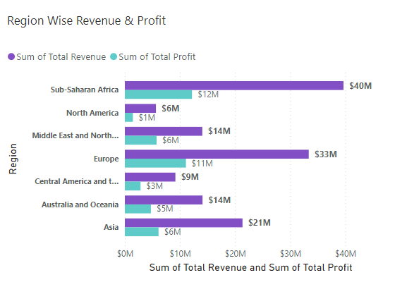
Regional Revenue & Profit Analysis
Regionally, Sub-Saharan Africa was the standout performer, leading in both revenue and profit with $40M and $12M, respectively.
Europe also showed strong results, with $33M in revenue and $11M in profit.
The Middle East and North Africa region was notable for its high profitability, achieving $14M in profit from $21M in revenue.
North America, while contributing $11M in revenue, had relatively lower profit margins at $6M.
Asia, with $21M in revenue, demonstrated a balanced profit contribution of $6M. Central America and Oceania, and Australia and Oceania regions, also contributed positively to the overall profit margins.

Slide 9
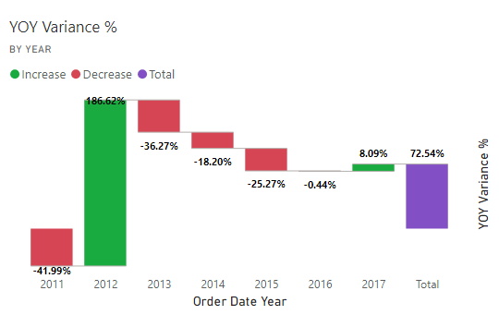
Yearly Sales Trend
These insights highlight the need for strategic measures to stabilize growth and sustain positive momentum in sales performance.
The YOY variance chart reveals significant fluctuations in Amazon's sales growth across the analyzed years. In 2011, the company experienced a notable decline of 41.99%.
However, 2012 marked a remarkable recovery with an increase of 186.62%, indicating a substantial turnaround.
The following years saw a decline, with 2013 experiencing a 36.27% drop, followed by decreases of 18.20% in 2014 and 25.27% in 2015.
The trend stabilized in 2016 with a marginal decline of 0.44%.
In 2017, there was a positive shift, with an 8.09% increase. Overall, the total YOY variance for the period stands at 72.54%, reflecting an overall positive growth trend despite the fluctuations.
The significant recovery in 2012 and positive growth in 2017 provide a basis for identifying successful strategies and areas for improvement.

Slide 10
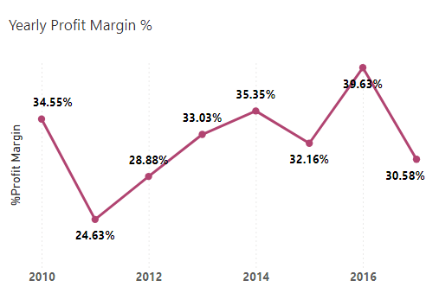
Yearly Profit Margin %
The chart shows the yearly profit margin percentages for a business from 2010 to 2017.
It reveals a fluctuation in profitability, starting at 34.55% in 2010, dipping to a low of 24.63% in 2011, and peaking at 39.63% in 2016 before declining to 30.58% in 2017.
This indicates inconsistent profit margins over the years.

Slide 11
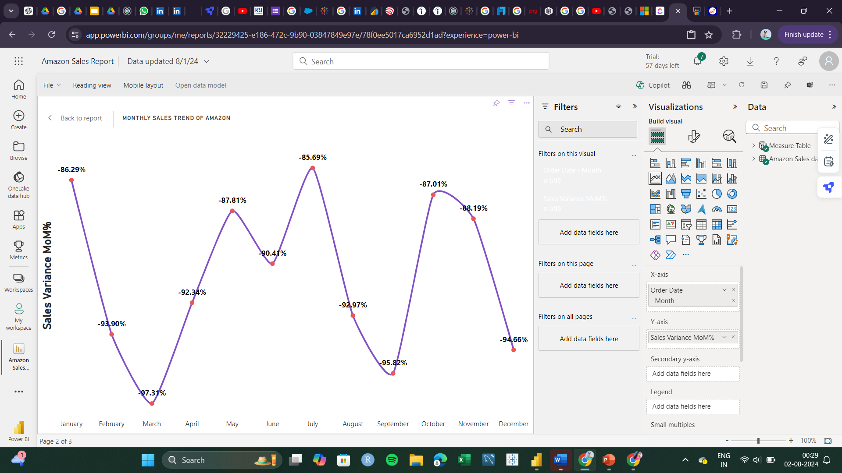
Monthly Sales Trend
The chart illustrates the month-over-month sales variance percentage, showing consistent negative trend throughout the year.
The lowest point occurs in March with a -97.31% variance, indicating a significant drop in sales compared to the previous month.
The highest negative variance is seen in July at -85.69%, suggesting a lesser decline in sales compared to other months.
Overall, the data indicates a challenging sales environment, with significant fluctuations and a general downward trend in sales performance across all months.
This pattern may highlight issues in market demand, product performance, or external factors impacting sales.

Slide 12
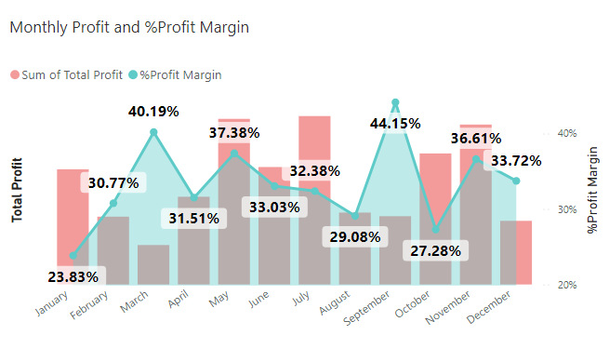
Monthly Profit and Profit Margin Analysis
Profit Peaks and Troughs:
December shows the highest total profit, likely due to the holiday shopping season, indicating a significant increase in sales.
January and February typically have lower total profits, suggesting a post-holiday sales slump.
Profit Margin Trends:
Despite high total profits in December, the profit margin percentage might not be at its peak, indicating higher costs associated with increased sales volume, such as marketing and logistics.
March to April sees an increase in profit margin percentage, suggesting improved cost management or operational efficiency.
June has a high total profit but a relatively lower profit margin percentage, indicating higher costs or less efficient operations during this period.

Slide 13



Key Outcome
Geographic Reach
Serving 76 countries indicates a broad international presence.
Sub-Saharan Africa emerges as the top-performing region, highlighting potential for further growth in emerging markets.
Operational Efficiency
The gap between total revenue and total cost lines in the yearly chart indicates maintaining profitability while scaling operations.
Market Adaptation
Success across different regions (Sub-Saharan Africa, North America, Middle East, Europe, etc.) shows the company's ability to adapt to diverse markets.

Slide 14


Conclusion
Amazon’s sales performance has shown robust growth and profitability over the analyzed period.
Yearly Growth: The company has experienced consistent sales growth year over year, with notable peaks in profit margins indicating periods of high profitability.
Monthly Trends: Monthly analysis reveals that June and July are particularly strong months for revenue and profit, with June showing the highest profit margins
Growth Trend: The yearly chart shows an overall upward trend in both revenue and costs from 2010 to 2016. This suggests consistent business growth over the years.
Product Distribution: Sales are well-distributed across various item types, with Books, Electronics, Apparel, and Food all contributing significantly to total sales.
Effective Sales Channels: Offline sales ($79.09M, 57.59%) outperform online sales ($58.25M, 42.41%). This suggests the company's traditional retail channels are still crucial to its success.
Overall Financial Health: The comprehensive analysis highlights Amazon’s strong financial health, with diverse product performance and effective sales strategies contributing to its success.

Slide 15




Thank you

